Slide 1
Object Oriented Programming
Abeer GAUHER
Email: abeer.gauher@nu.edu.pk
Office: CS BASEMENT 2, Office number 23

Slide 2
Casting
When we convert one data type into another type, the process is called typecasting.
Upcasting and downcasting are the types of object typecasting.
Suppose the Parent and Child class has two types of object, parent_obj and child_obj, which can be cast into Parent to Child and Child to Parent using Upcasting and Downcasting.

Slide 3
UpCasting
It is the process to create the derived class's pointer or reference from the base class's pointer or reference.
Upcasting is used to convert the reference or pointer of the derived class to a base class. Upcasting is safe casting as compare to downcasting.
By default, upcasting creates is-a relationship between the base and derived classes.

Slide 4
UpCasting
Base *ptr = &derived_obj;
The derived class can inherit all the base class properties that include data members and the member function to execute the function using the derived class object, as we do with a base object.

Slide 5
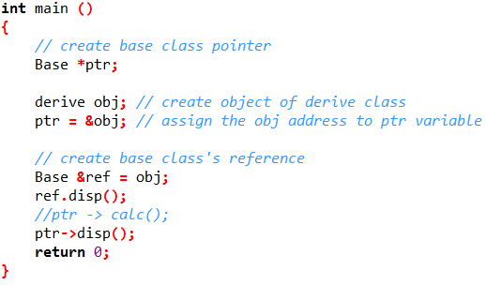
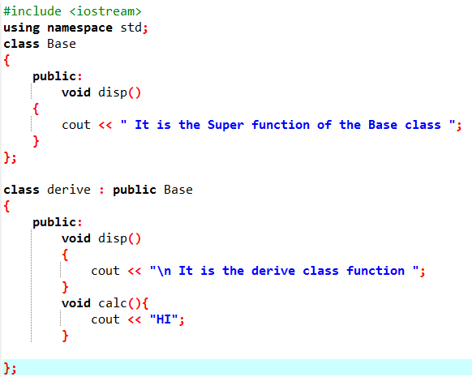
UpCasting

Slide 6
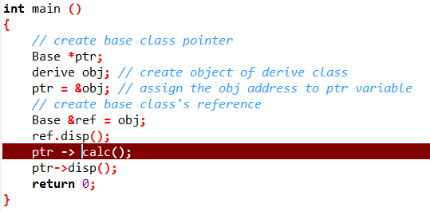
UpCasting

Slide 7
DownCasting
Downcasting occurs when we cast downwards from Parent to Child.
Downcasting is not as safe as Upcasting, hence it will thrown an error if an implicit conversion is attempted.
In order to perform Downcasting, you need to forcefully cast it.
The downcasting does not follow the is- a relation in most of the cases. It is not safe as upcasting.

Slide 8
DownCasting
Derived *d_ptr = &b_obj;

Slide 9
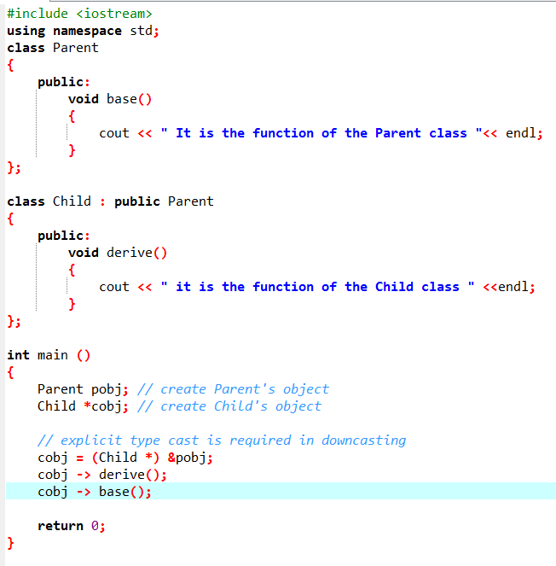

DownCasting

Slide 10
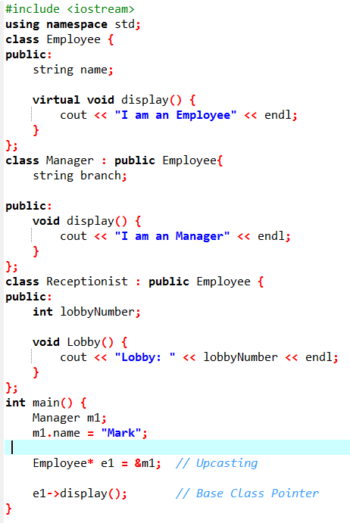

Examples
Upcasting

Slide 11
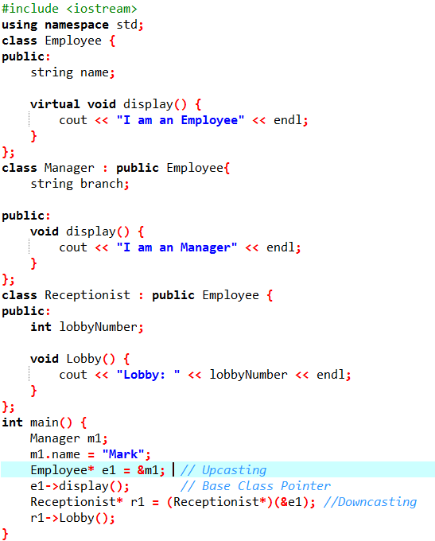

Examples
Downcasting

